Slide 1


The Basics of
&

Slide 2
Agenda
React
Overview
JavaScript XML (JSX)
Components
Redux
Overview
Data flow
State change example

Slide 3
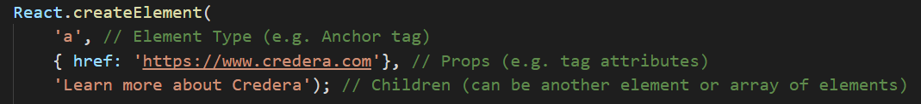
JavaScript library for building user interfaces
XML/HTML is rendered by JavaScript functions
Views are written in JavaScript
When data changes, React updates the effected components

Slide 4


JSX
JSX enables HTML to be interwoven with your JavaScript code
Preprocessor transforms XML/HTML into it’s JavaScript equivalent
Execute Babel Sequence!

Slide 5
Components
Event Occurs (e.g. user input, API response, etc.)
State
Data specific to an instance of a component
Props
Tag attributes passed by a parent
Stateful Components
Has a state
Render on state/props change
Stateless Components
Pure functions
Render only on props change
Lifecycle Hooks
Enable interception of changes at various stages of the component lifecycle
e.g. componentWillUpdate(nextProps, nextState)
State/Props Updated (e.g. car component has its car.name updated)
Car Component Re-Rendered with new state/props

Slide 6
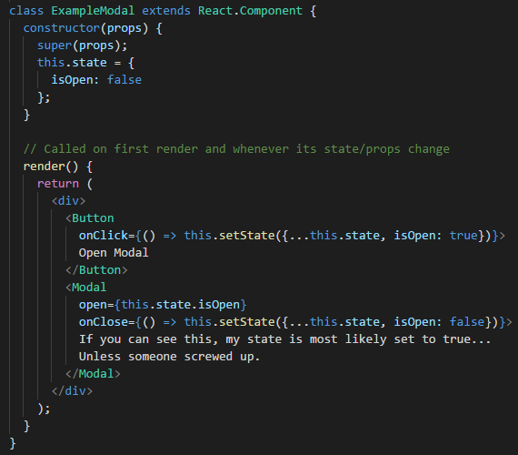
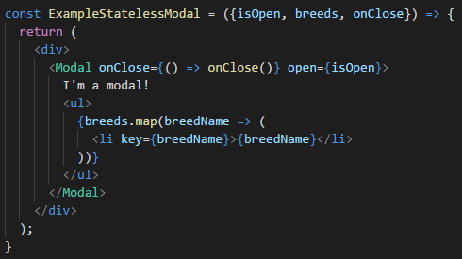
Stateful Component
Stateless Component

Slide 7
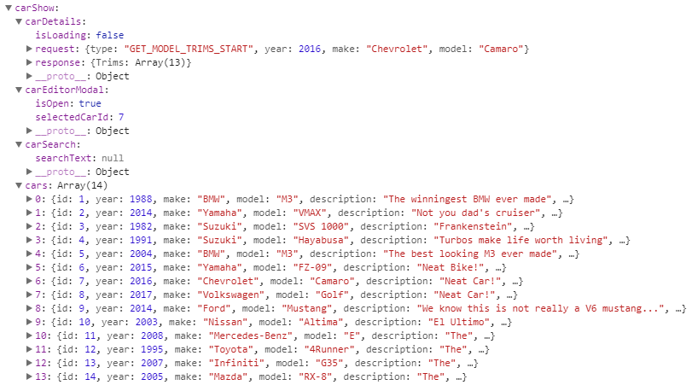
Redux is a state management library
All data is stored in a global state object
Every state change creates a brand new state object
Decouples components from the functionality

Slide 8
Redux Data-Flow
React Component
Interaction onClick={increment}
(state)
(newState)
Action Creator
Store
Global State Object
Reducers
dispatch(action)
(previousState, action)

Slide 9
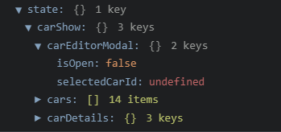



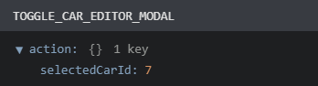
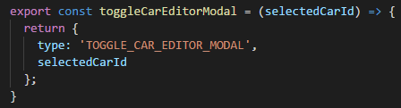
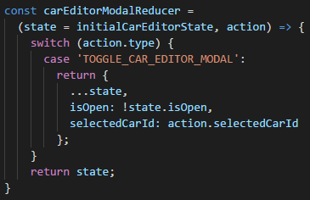
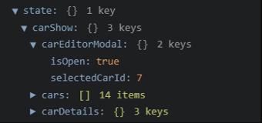


Slide 10
Car Show Demo
&

